Slide 1

IMPORT ANALYSIS (NIGERIA, 2019)
HERTECHTRAIL
DATA ANALYTICS PRO TRACK
GROUP 2

Slide 2
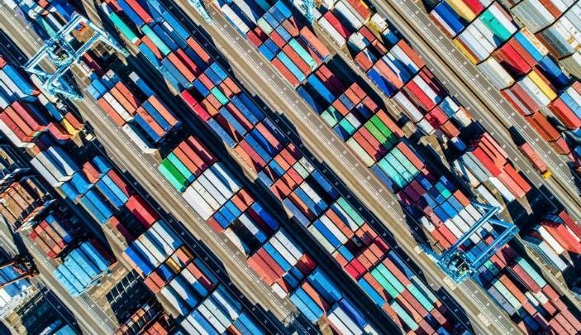
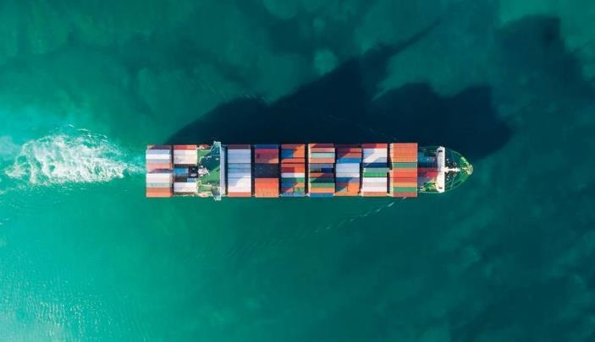
Agenda
Meet the Team
Introduction
Background
Analysis/Insights
Conclusion

Slide 3




Team
GRACE OGEDEGBE
WOFAI ALFRED EYONG
PEACE ISOKEN AZETA
AKANBI OLUWATOMISIN KHADIJAT
LinkedIn : Grace Ogedegbe
LinkedIn : Wofai Eyong
LinkedIn : Peace Azeta
LinkedIn : Oluwatomisin Akanbi

Slide 4




Team
BABALOLA RAHMOTALLAH MOSUNMOLA
CHIDINMA MBA
ADEGBAMIGBE SINMISOLA
NZELU OGECHUKWU CYNTHIA
LinkedIn : Rahmotallah Babalola
LinkedIn : Chidinma Mba
LinkedIn : Sinmisola Adegbamigbe
LinkedIn : Ogechukwu Nzelu

Slide 5
Introduction
As at 2018, Nigeria was the fifth largest importer in Africa with imports covering 6.6 per cent of the total share in Africa.

Slide 6
Background
This analysis was done to understand the import activities of Nigeria in the year 2019.
It answers question such as:
The top banks used by importers
Payment mode
Most used currency
Best time to import based on the price of dollar
Time of the year (month) when most of the import transactions were done
Top importers
Most and least expensive imported item
The insights derived are aimed towards importers and prospective importers.

Slide 7
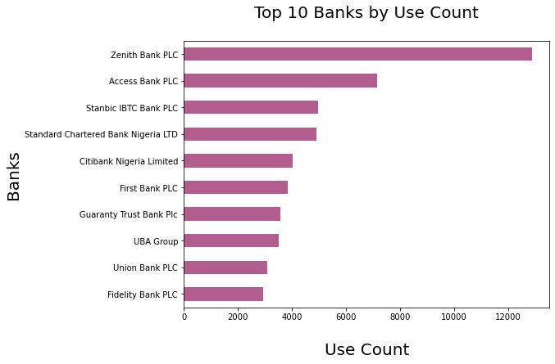
TOP BANKS
Based on the use count, Zenith bank was the most used bank with a total of 12881 transactions.
Access bank with a total of 7147 transactions was the second most used bank.

Slide 8
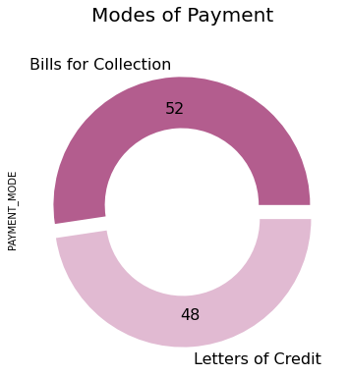
PAYMENT MODE
There were two modes of payment available; Bills for collection and Letters of credit.
Bills for collection is used more because the cost of issuing a Letter of Credit is higher than that of Bills for collection.

Slide 9
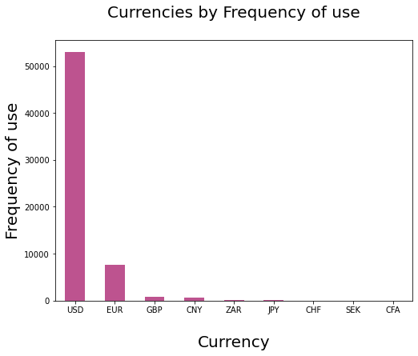
MOST USED CURRENCY
The USD (American Dollar) is the most used currency followed by the EUR (European Union Euro)
The bars for ZAR, JPY, CHF, SEK and CFA did not appear because the values associated with the currencies are negligible when compared to that of USD

Slide 10
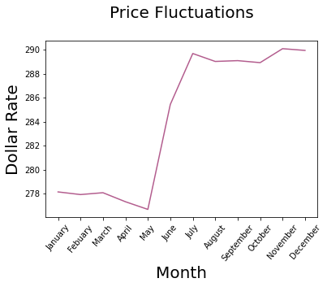
BEST TIME TO IMPORT
Based on the varying price of dollar throughout the year, the first five months of the year (January – May) is the best time to import as there is a spike in the rate of dollar exchange in June.

Slide 11
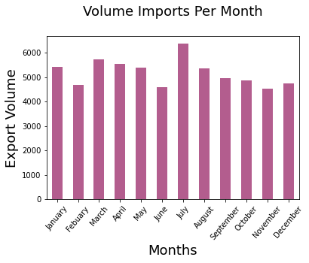
MONTH WITH THE MOST TRANSCATIONS
Most of the import transactions were done in the month of July. This is a possible explanation as to why dollar spiked so high in July as seen in the previous slide.

Slide 12
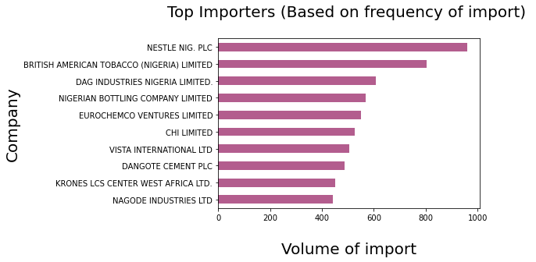
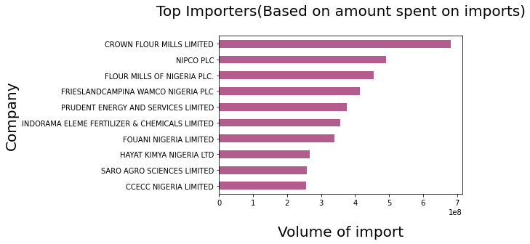
TOP IMPORTERS
Based on frequency of import, Nestle Nigeria PLC imported more than any other company in the year 2019 while Crown Flour Mills Limited imported more based on amount spent.
Nigeria’s top 10 importers (companies) are also an indicator of the most consumed goods within the country, food and beverage being at the top.

Slide 13
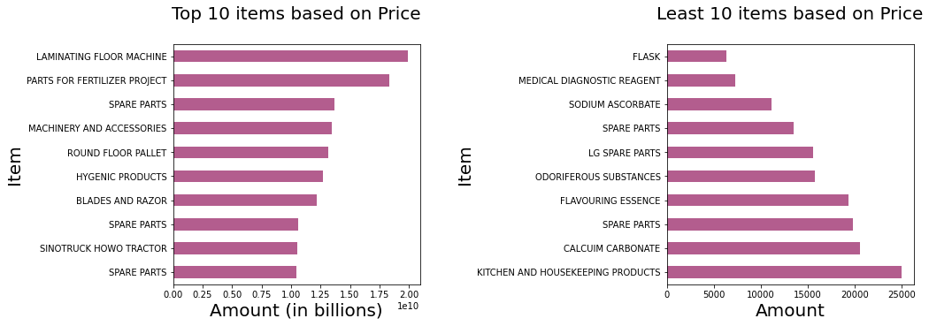
MOST & LEAST EXPENSIVE ITEM
The most expensive item imported in 2019 is the laminating flooring machine. It is used for laminating floor. The least expensive item was flask.

Slide 14
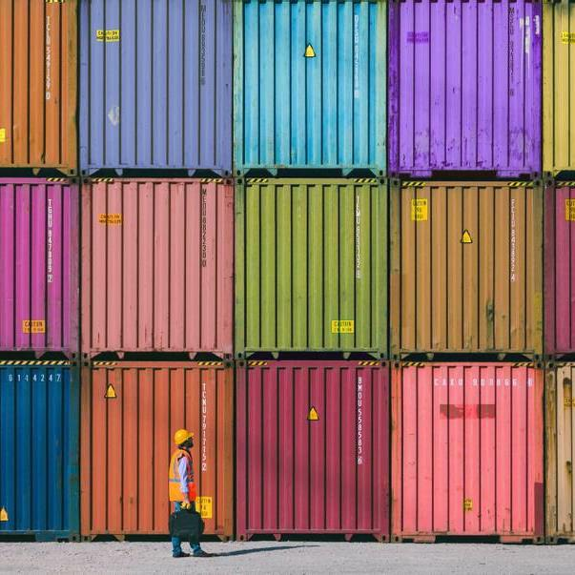
Conclusion
Based on the most used currency (USD), America (or countries in which the USD is the primary currency) supplied most of Nigeria's import in the year 2019. The bulk of these transactions were facilitated in the month of July through Zenith Bank which is a possible reason for the dollar-naira exchange rate spike in July.

Slide 15
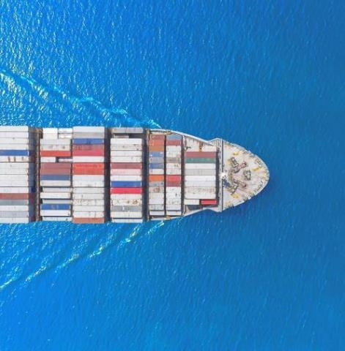
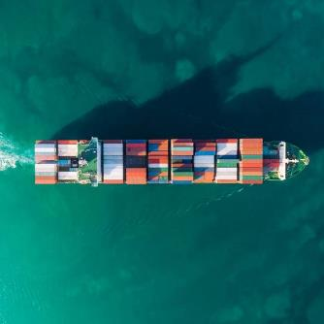
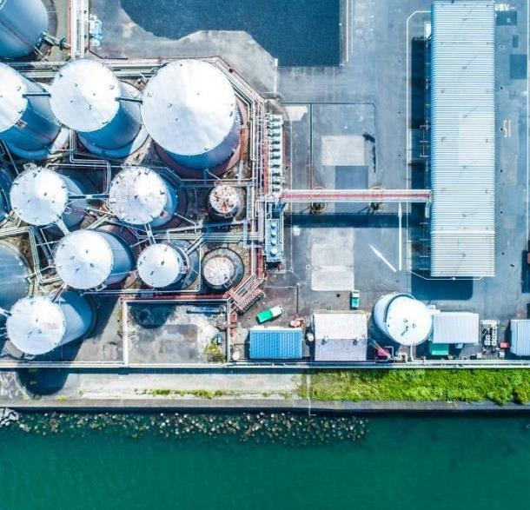
THANK YOU

